Slide 1




Quantifying spatial heterogeneity of malaria
in the endemic Papua region of Indonesia:
analysis of epidemiological surveillance data
in over 446,000 individuals
Ihsan Fadilah
Eijkman-Oxford Clinical Research Unit
Jakarta, Indonesia
email: ifadilah@eocru.org

Slide 2


Slide 3
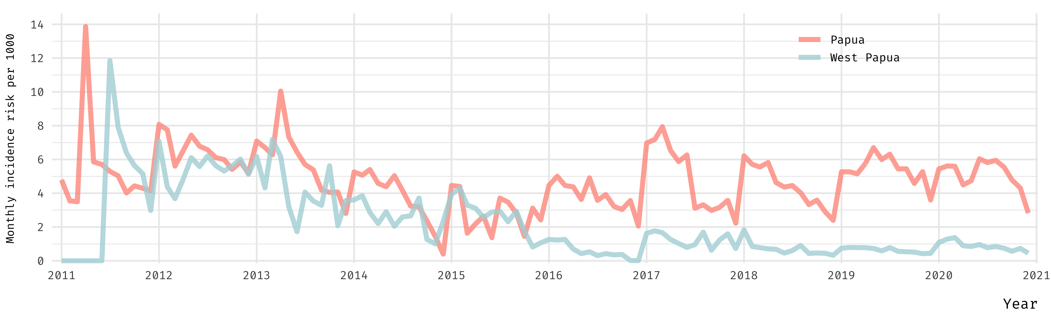
Malaria in Papua Indonesia over the past decade

Slide 4


Slide 5
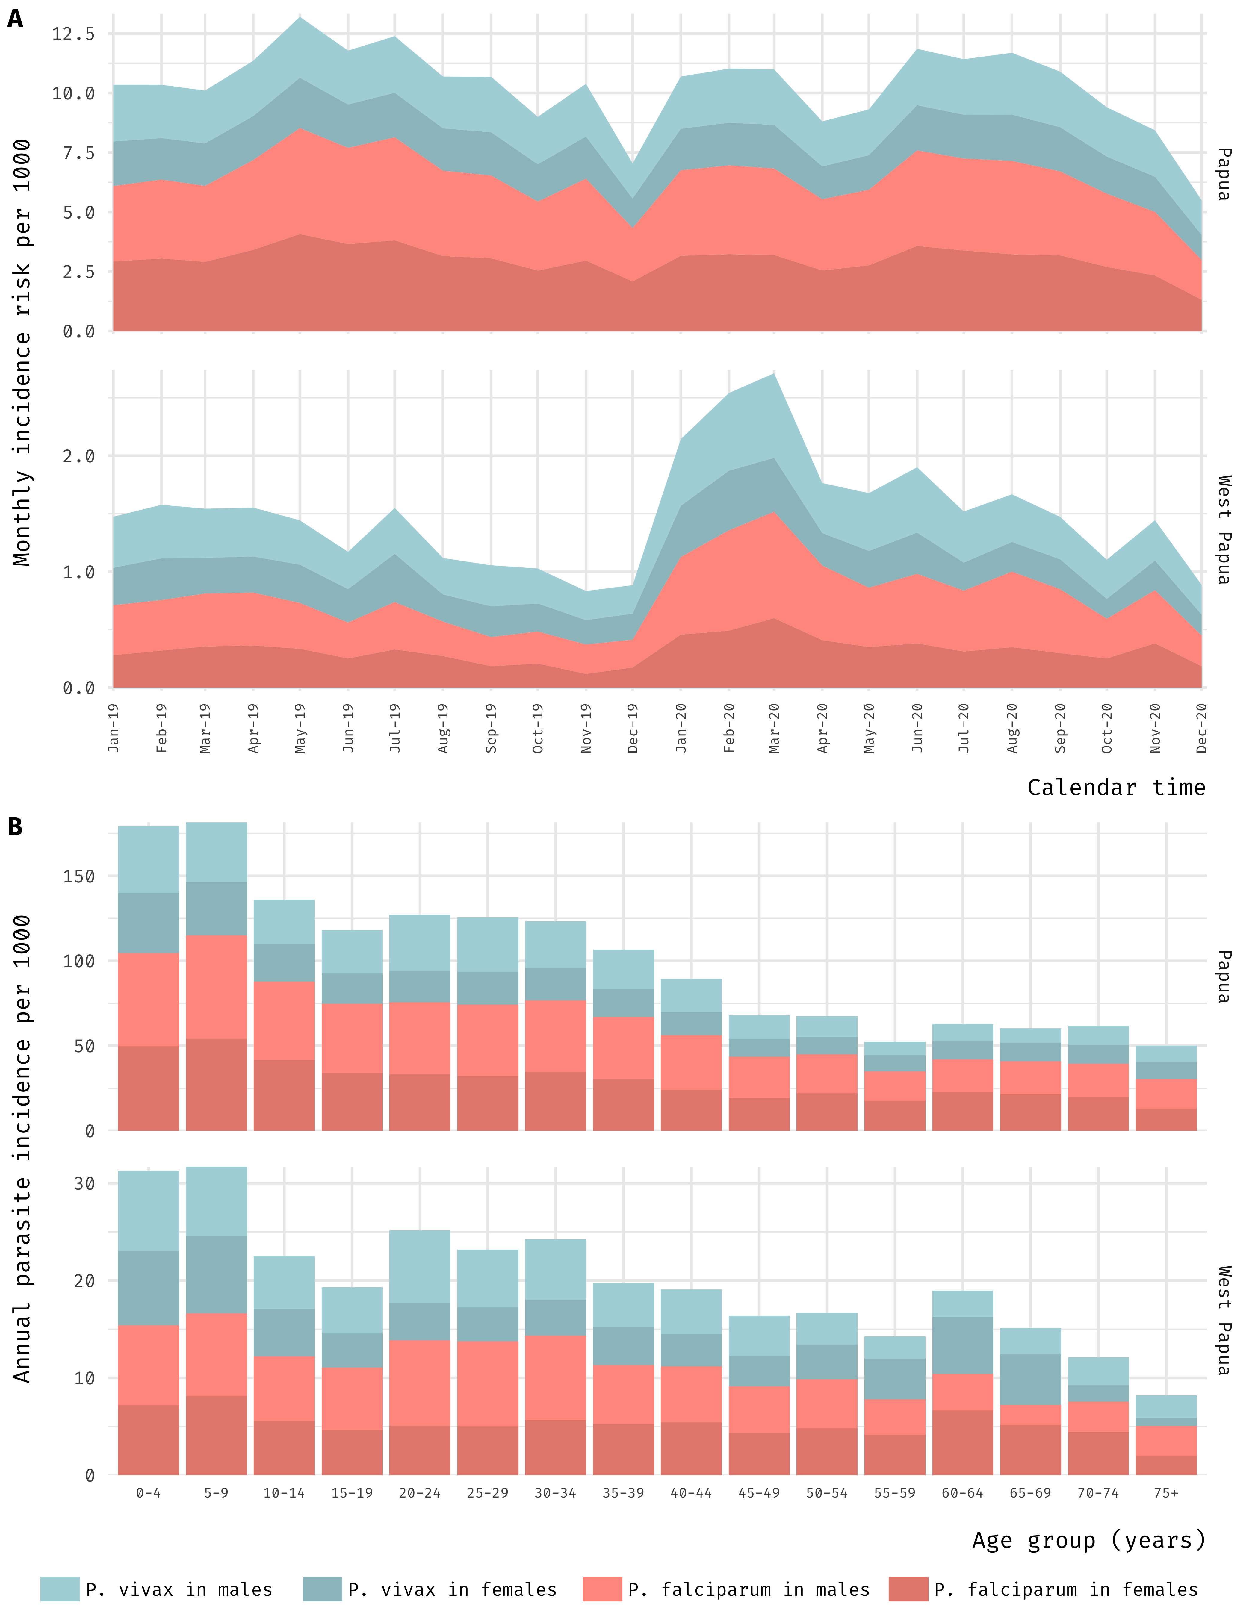
Transmission intensity over the past two years

Slide 6
Province-specific, reported malaria cases across age groups

Slide 7
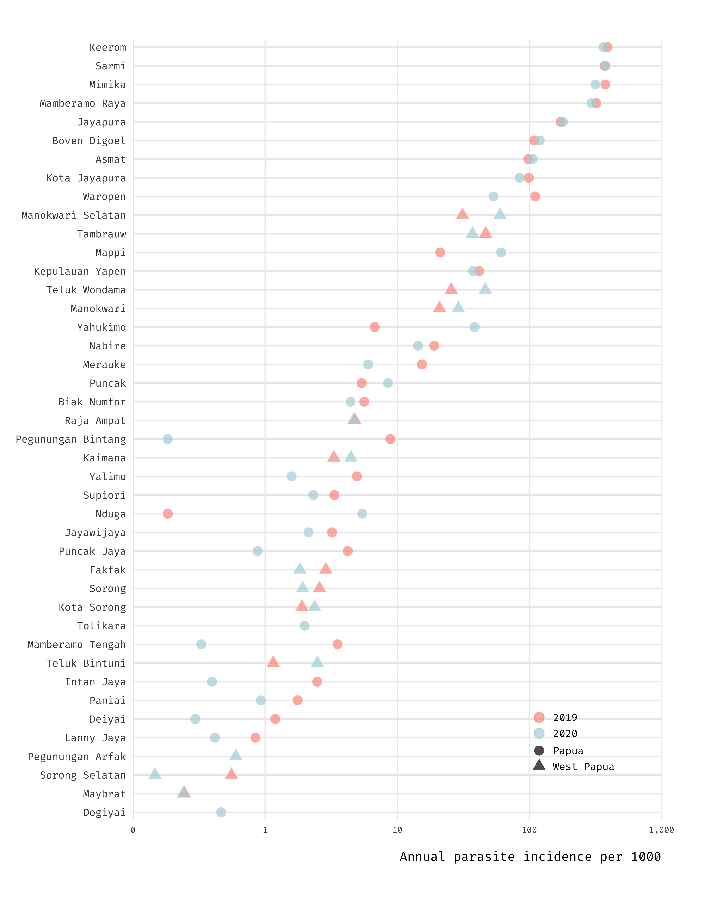
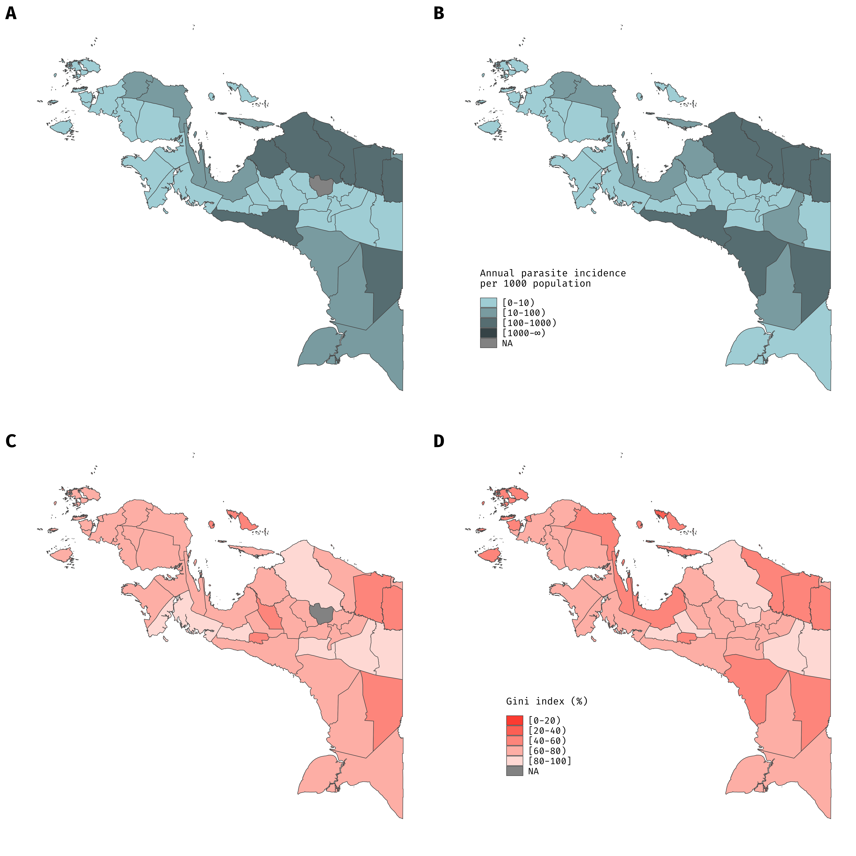

Slide 8
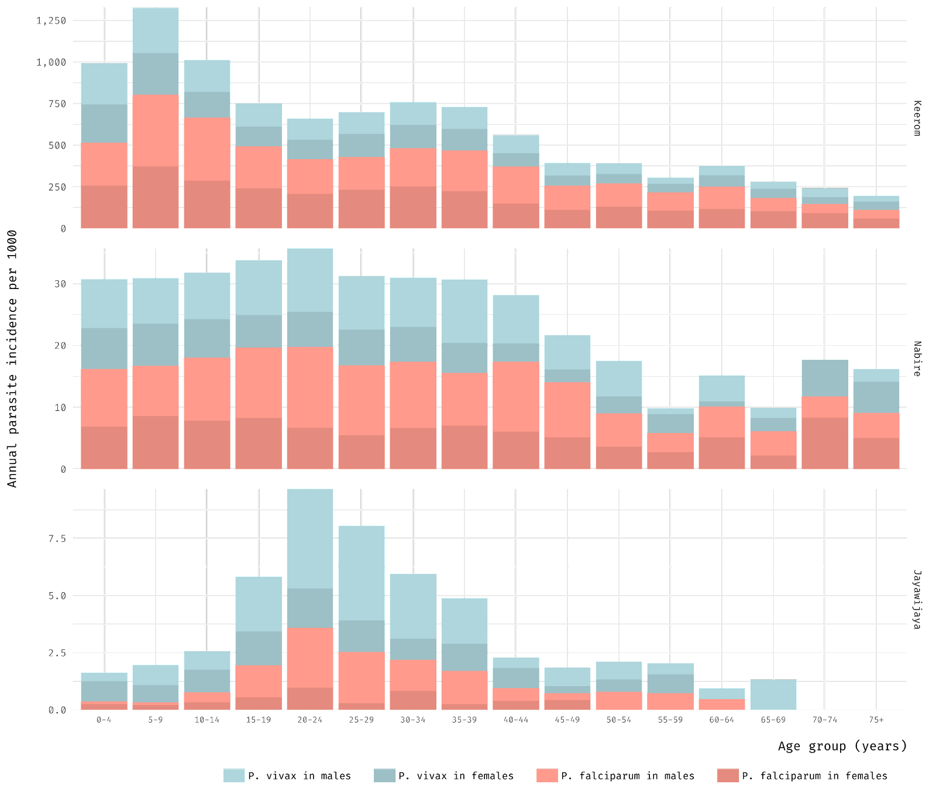

Slide 9
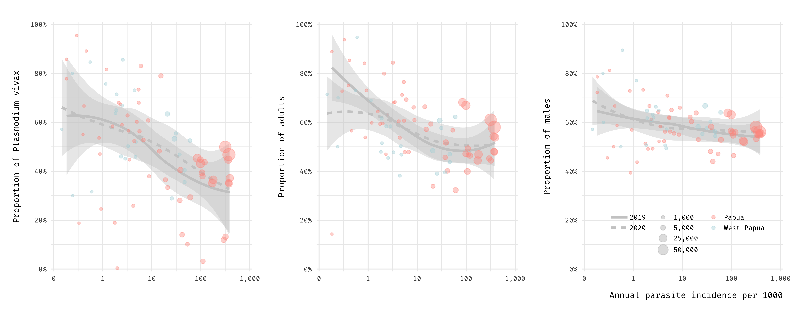
year
number of
cases
province

Slide 10
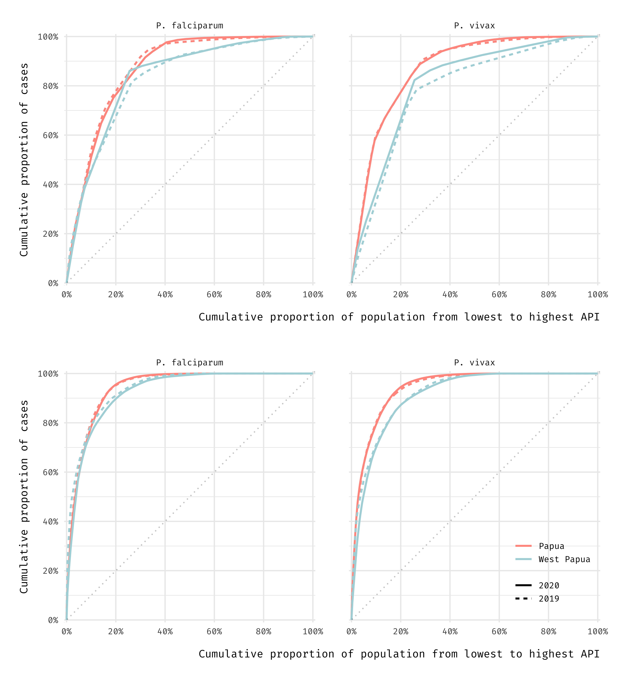
80:20
80:10
Notes:
add lines and numbers from table.

Slide 11
Transmission intensity and
spatial heterogeneity (2020)

Slide 12
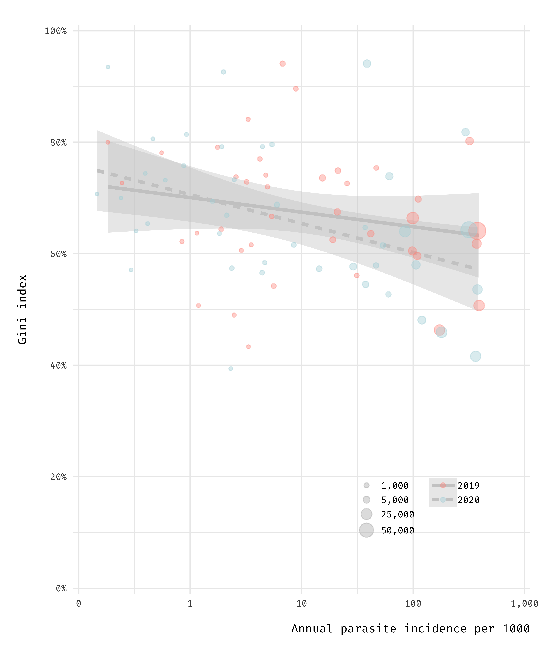
Inverse relationship
between district-specific, spatial heterogeneity and transmission intensity
number of
cases
year

Slide 13
Authors
Acknowledgements

Slide 14
Quantifying spatial heterogeneity of malaria
in the endemic Papua region of Indonesia:
analysis of epidemiological surveillance data
Ihsan Fadilah
Eijkman-Oxford Clinical Research Unit
Jakarta, Indonesia
email: ifadilah@eocru.org

Slide 15
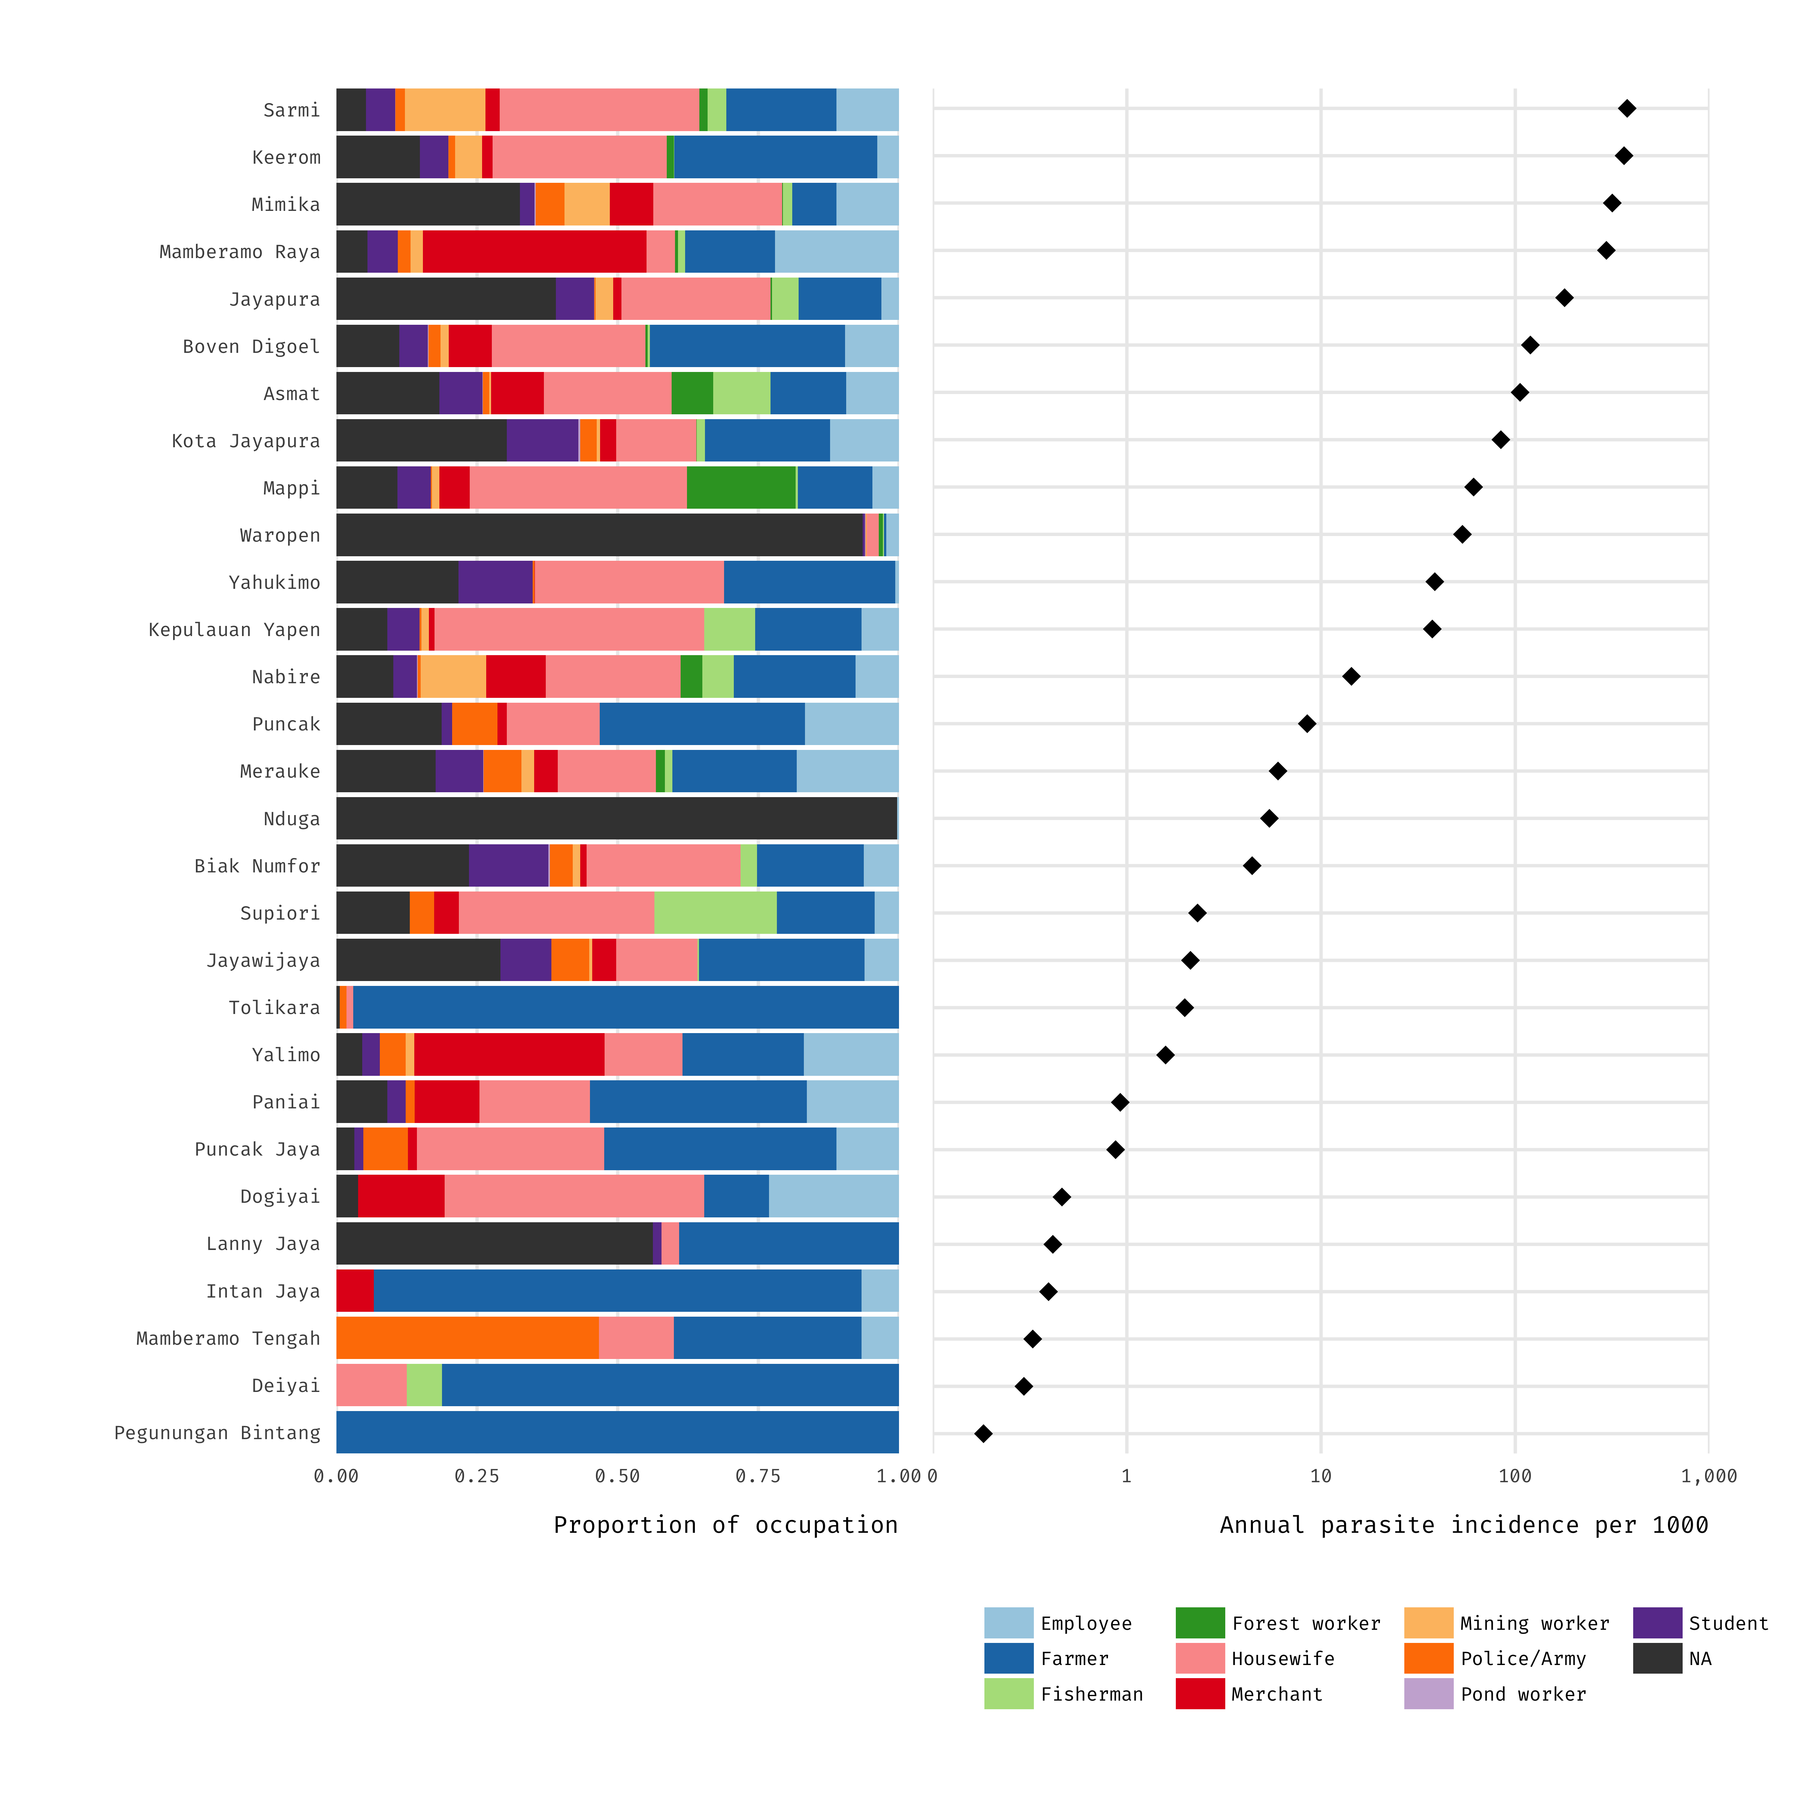

Slide 16
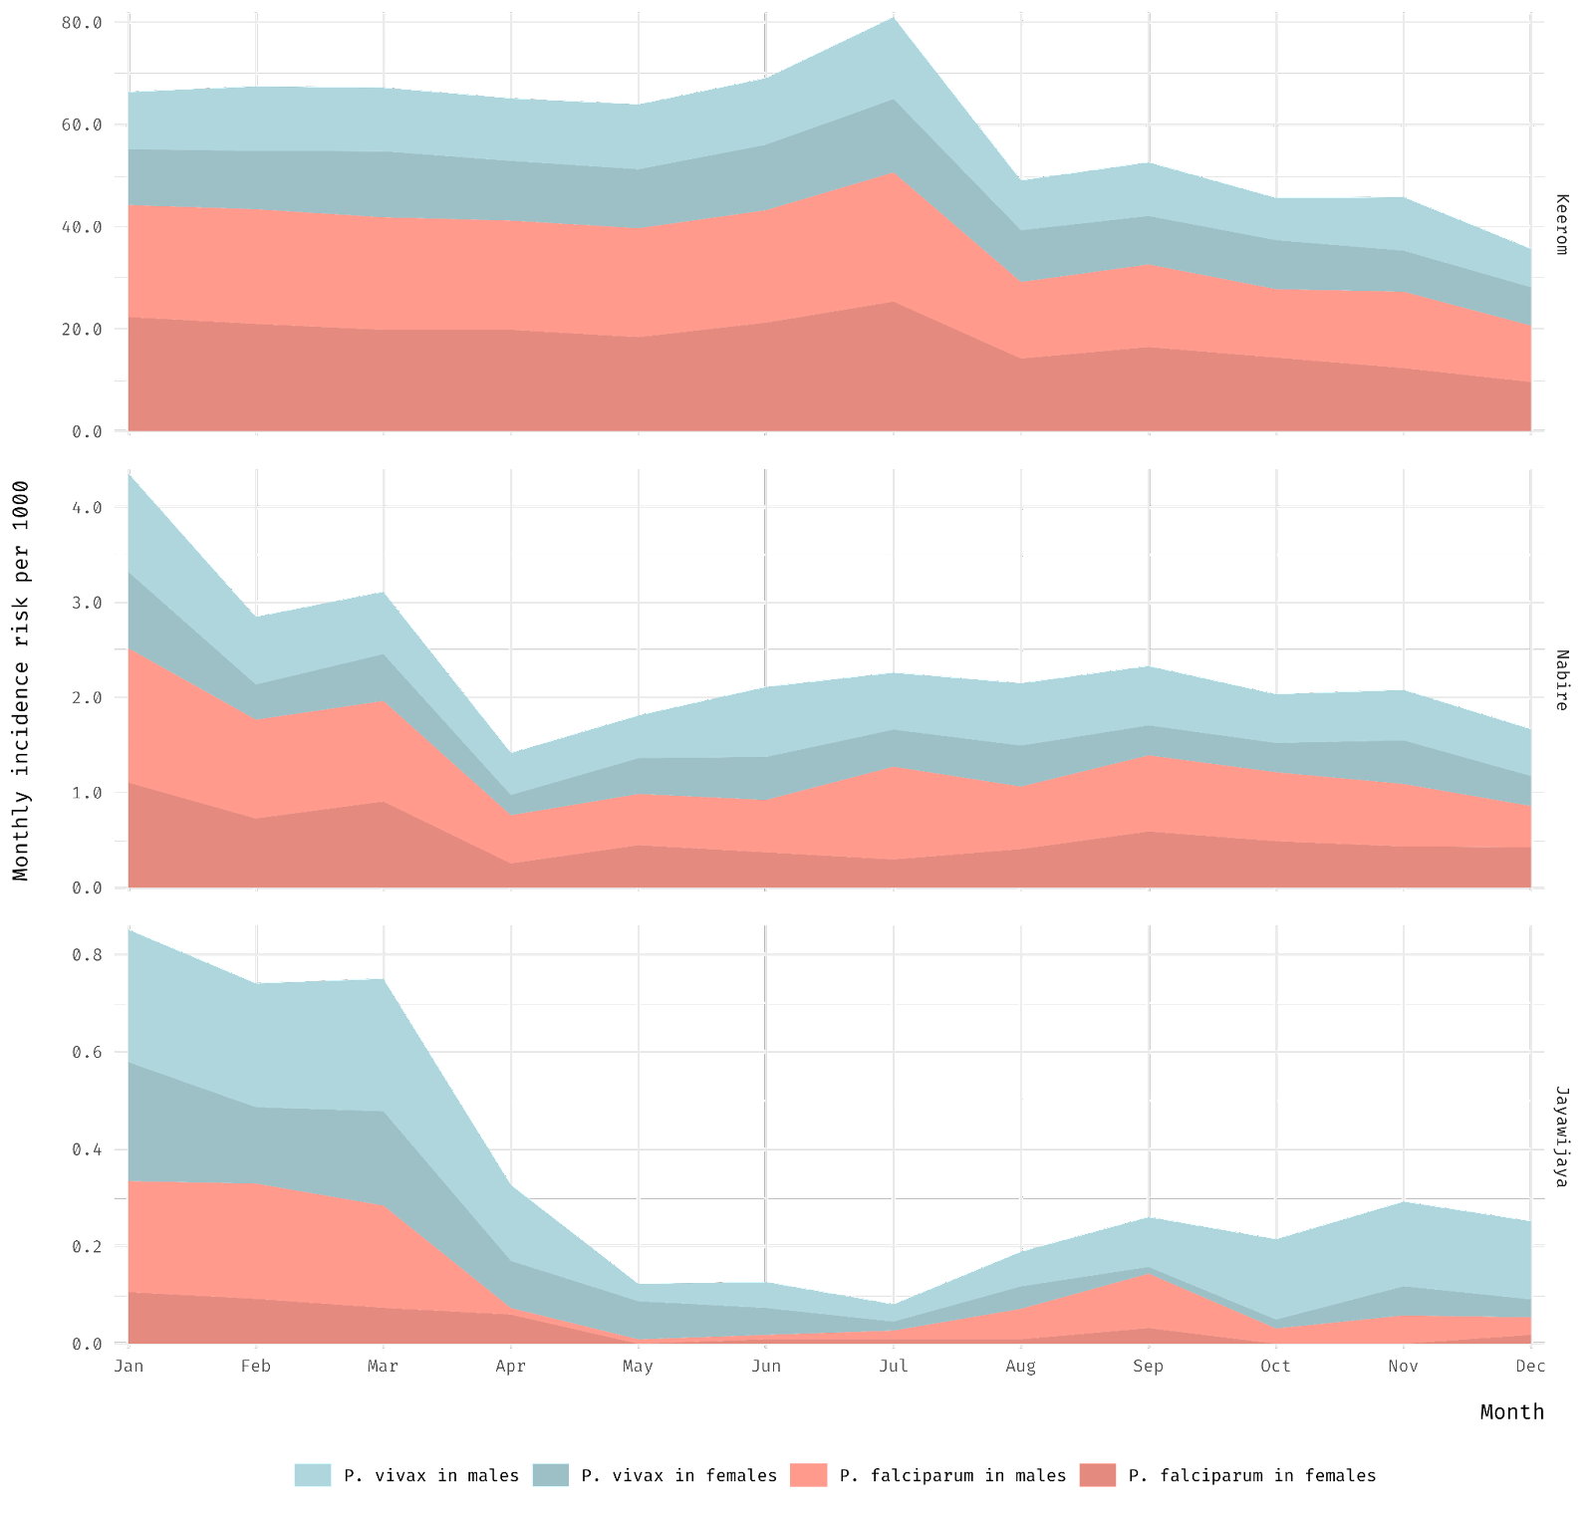

Slide 17
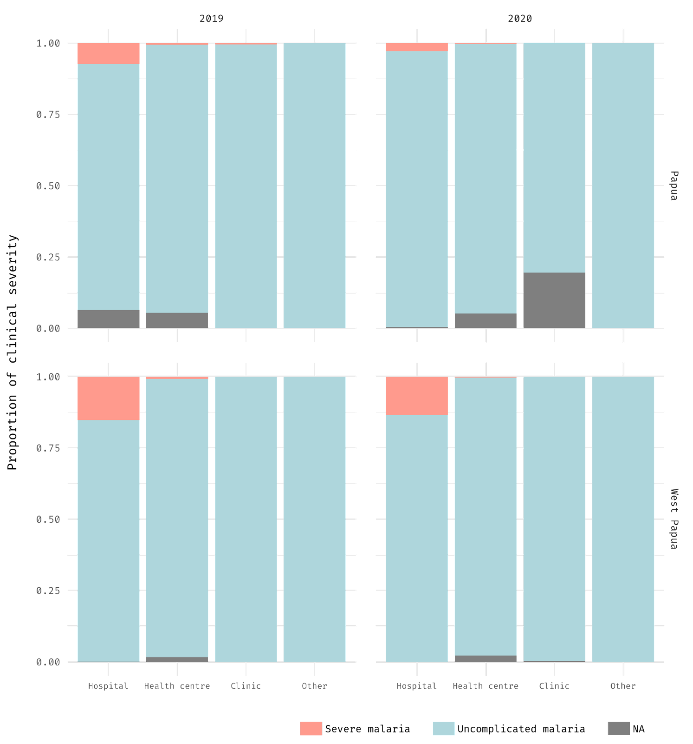

Slide 18
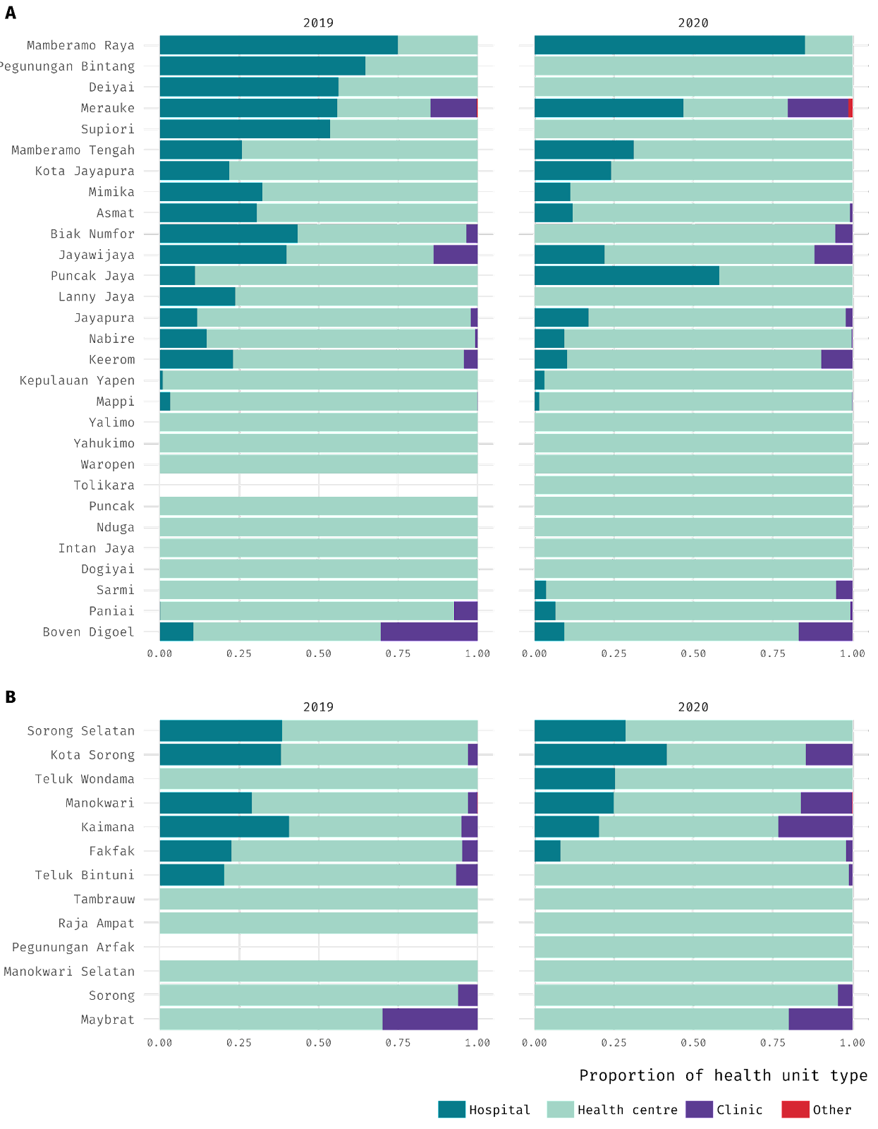

Slide 19
